Slide 1
Introduction to
8086 and its Architecture
Dr. Suresh Balusamy Associate Professor Dept of Mathematics and Computer Applications PSG College of Technology

Slide 2
Topics
First micro processor by Intel
8086 micro processor
Block diagram
and so on …

Slide 3
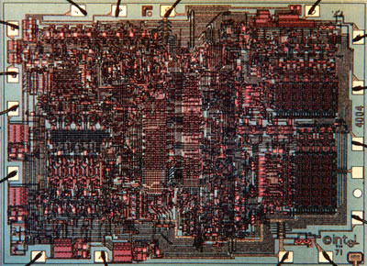
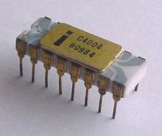
1971: Intel’s First Microprocessor 4004

Slide 4
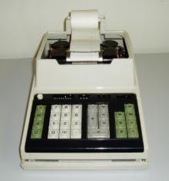
Application of First Microprocessor 4004
This calculator from Busicom first used the microprocessor.

Slide 5
Interesting facts
The Intel 4004 was originally designed for use in a Busicom scientific calculator, but Intel engineers realized the design of the chip afforded multi-purpose use - thus the microprocessor was born.
The 4004 contains 2000 transistors and is a 4-bit microprocessor capable of processing 4 bits of information at a time at a rate of about 0.06 MHz.
Compare this to current microprocessors that contain many millions of transistors and whose clock speed is measured in GHz. But the 4004 found widespread use in many applications, including being used on the Pioneer 10 spacecraft launched in 1972.
For many years Pioneer 10 held the record as the most distant man-made object, until it was surpassed by Voyager 1 in 1998. Pioneer 10 continued to transmit data back to Earth until its radioisotope power source died in 2003.

Slide 6
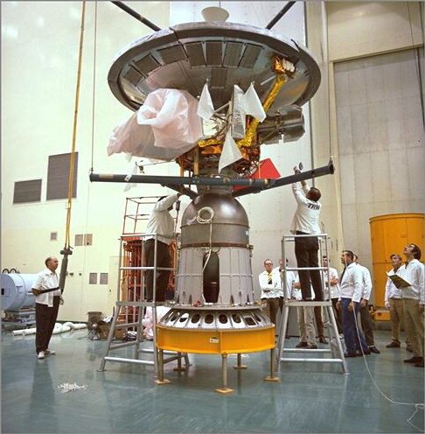

Slide 7
Evolution of the microprocessor
4004
4040
8008
8080
8085

Slide 8
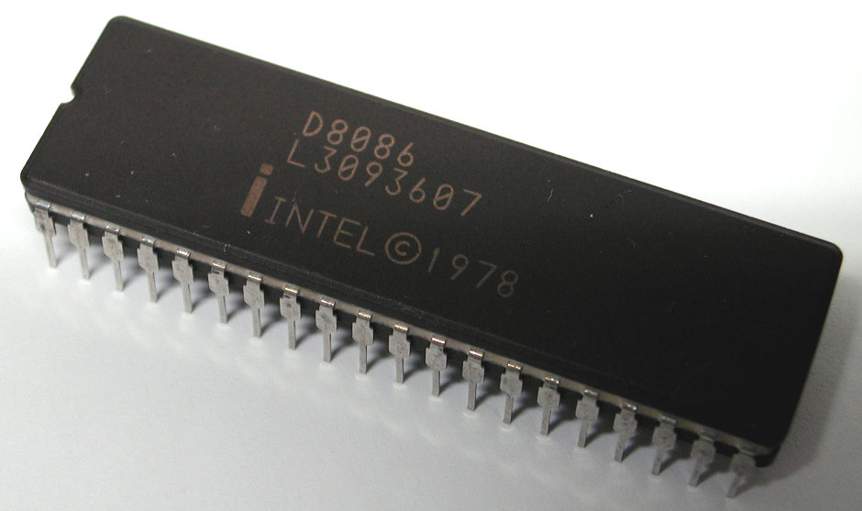
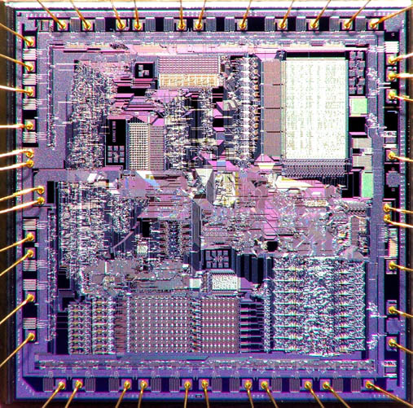
Birth of 8086 in 1978
and later 8088 … 80286… 80386

Slide 9
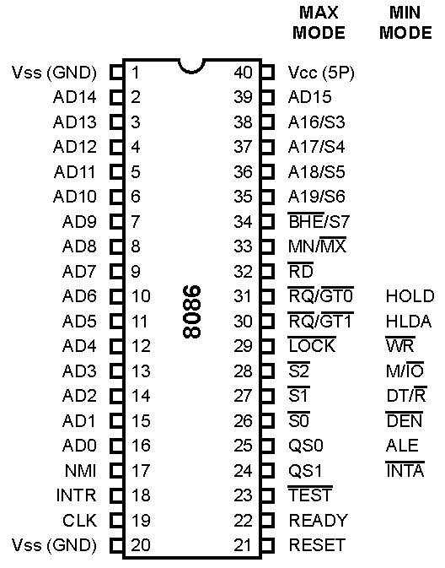
PIN diagram of 8086

Slide 10
Why 8086 is so special…. ? An million $ question
It introduced instruction cache / queue
That leads the modern processor with huge cache
That leads to MIPS architecture
and so on …

Slide 11
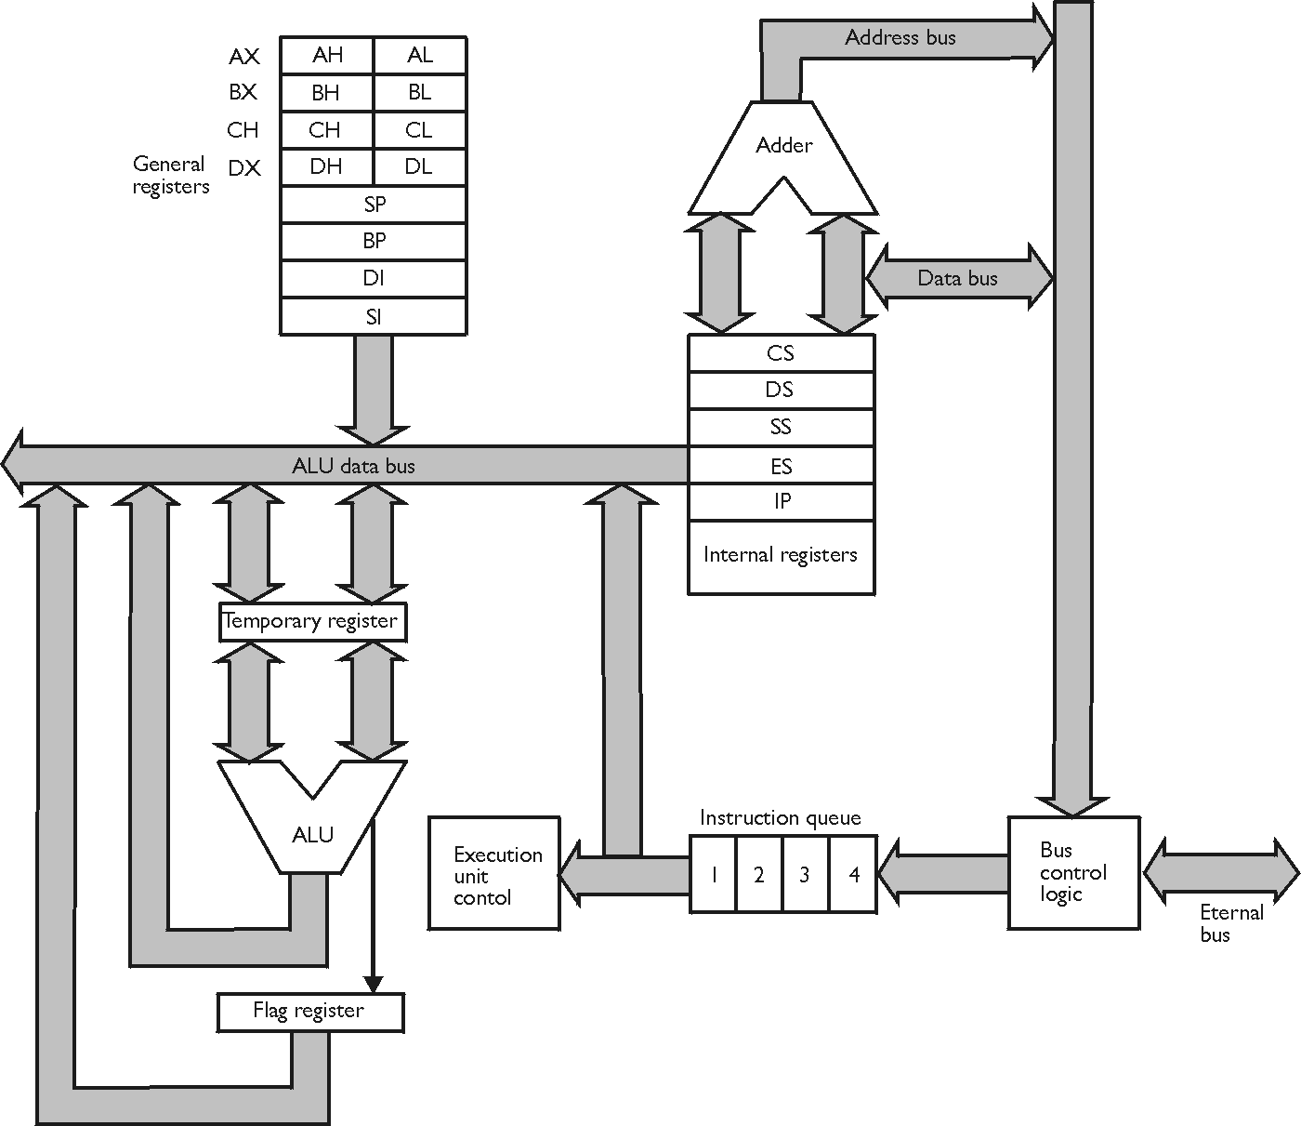
Block diagram of 8086
A(20)
D(8)
EU – Execution unit
BIU – Bus interface unit
D(16)
Q(8)

Slide 12
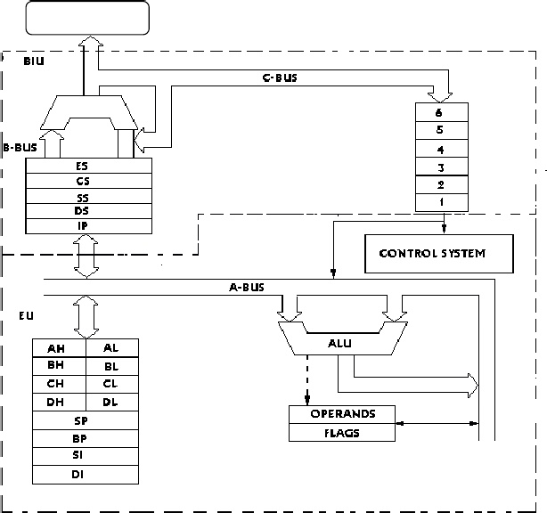

Slide 13
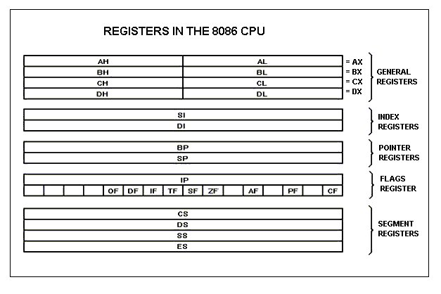

Slide 14
AX - the accumulator register (divided into AH / AL):
1. Generates shortest machine code
2. Arithmetic, logic and data transfer
3. One number must be in AL or AX
4. Multiplication & Division
5. Input & Output
BX - the base address register (divided into BH / BL).
CX - the count register (divided into CH / CL):
1. Iterative code segments using the LOOP instruction
2. Repetitive operations on strings with the REP command
3. Count (in CL) of bits to shift and rotate

Slide 15
DX - the data register (divided into DH / DL):
1. DX:AX concatenated into 32-bit register for some MUL and DIV operations
2. Specifying ports in some IN and OUT operations
SI - source index register:
1. Can be used for pointer addressing of data
2. Used as source in some string processing instructions
3. Offset address relative to DS
DI - destination index register:
1. Can be used for pointer addressing of data
2. Used as destination in some string processing instructions
3. Offset address relative to ES

Slide 16
BP - base pointer:
1. Primarily used to access parameters passed via the stack
2. Offset address relative to SS
SP - stack pointer:
1. Always points to top item on the stack
2. Offset address relative to SS
3. Always points to word (byte at even address)
4. An empty stack will had SP = FFFEh

Slide 17
SEGMENT REGISTERS
CS - points at the segment containing the current program.
DS - generally points at segment where variables are defined.
ES - extra segment register, it's up to a coder to define its usage.
SS - points at the segment containing the stack
IP - the instruction pointer: Always points to next instruction to be executed
Offset address relative to CS
IP register always works together with CS segment register and it points to currently executing instruction.

Slide 18
Association of Registers
CS - IP
DS – SI, BX
ES - DI
SS – BP, SP

Slide 19
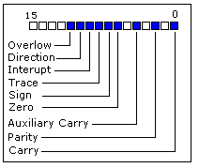
FLAG REGISTER

Slide 20
Carry Flag (CF) - this flag is set to 1 when there is an unsigned overflow. For example when you add bytes 255 + 1 (result is not in range 0...255). When there is no overflow this flag is set to 0.
Parity Flag (PF) - this flag is set to 1 when there is even number of one bits in result, and to 0 when there is odd number of one bits.
Auxiliary Flag (AF) - set to 1 when there is an unsigned overflow for low nibble (4 bits).
Zero Flag (ZF) - set to 1 when result is zero. For non-zero result this flag is set to 0.
Sign Flag (SF) - set to 1 when result is negative. When result is positive it is set to 0. (This flag takes the value of the most significant bit.)
Trap Flag (TF) - Used for on-chip debugging.

Slide 21
Interrupt enable Flag (IF) - when this flag is set to 1 CPU reacts to interrupts from external devices.
Direction Flag (DF) - this flag is used by some instructions to process data chains, when this flag is set to 0 - the processing is done forward, when this flag is set to 1 the processing is done backward.
Overflow Flag (OF) - set to 1 when there is a signed overflow. For example, when you add bytes 100 + 50 (result is not in range -128...127).

Slide 22
Addressing Mode of 8086

Slide 23
Types of Addressing mode
Register addressing mode
Immediate addressing mode
Direct addressing mode / displacement
Indirect addressing mode
Indexed addressing mode / index AM
Based Indexed addressing mode
Base indexed displacement addressing mode.

Slide 24
Most 8086 instructions can operate on the 8086's general purpose register set. By specifying the name of the register as an operand to the instruction, you may access the contents of that register. Consider the 8086
mov destination, source

Slide 25
Register addressing mode
mov ax, bx ;Copies the value from BX into AX
mov dl, al ;Copies the value from AL into DL
mov si, dx ;Copies the value from DX into SI
mov sp, bp ;Copies the value from BP into SP
mov dh, cl ;Copies the value from CL into DH
mov ax, ax ;Yes, this is legal!
Immediate addressing mode
mov ax, 10H ;
mov dl, FFH ;
mov si, ADH ;
mov sp, 123H;
mov dh, AH;

Slide 26
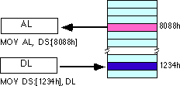
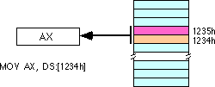
Direct addressing mode
mov AL, DS:[8080h];
mov DS:[1234h], DL;
ES:[1000h];
CS:[ACh];

Slide 27
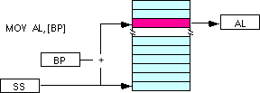
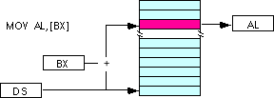
Indirect addressing mode
mov al, [bx]
mov al, [bp]
mov al, [si]
mov al, [di]
mov al, cs:[bx]
mov al, ds:[bp]
mov al, ss:[si]
mov al, es:[di]

Slide 28
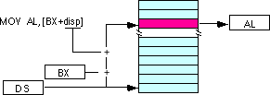
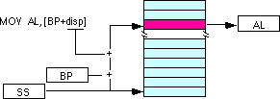
Indexed addressing mode
mov al, disp[bx]
mov al, disp[bp]
mov al, disp[si]
mov al, disp[di]
If bx contains 1000h, then the instruction mov cl, 20h[bx] will load cl from memory location ds:1020h.
Likewise, if bp contains 2020h, mov dh,1000h[bp] will load dh from location ss:3020.
mov al, ss:disp[bx]
mov al, es:disp[bp]
mov al, cs:disp[si]
mov al, ss:disp[di]
You may substitute si or di in the figure above to obtain the [si+disp] and [di+disp] addressing modes.

Slide 29
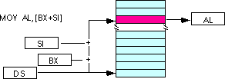
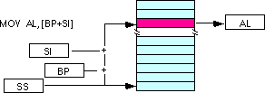
Based Indexed addressing mode
mov al, [bx][si]
mov al, [bx][di]
mov al, [bp][si]
mov al, [bp][di]
Suppose that bx contains 1000h and si contains 880h. Then the instruction
mov al,[bx][si]
would load al from location DS:1880h. Likewise, if bp contains 1598h and di contains 1004, mov ax,[bp+di] will load the 16 bits in ax from locations SS:259C and SS:259D.

Slide 30
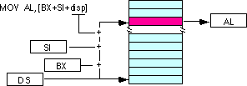
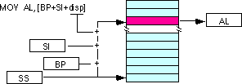
Base indexed displacement addressing mode
mov al, disp[bx][si]
mov al, disp[bx+di]
mov al, [bp+si+disp]
mov al, [bp][di][disp]
You may substitute di in the figure above to produce the [bx+di+disp] addressing mode.
You may substitute di in the figure above to produce the [bp+di+disp] addressing mode. Suppose bp contains 1000h, bx contains 2000h, si contains 120h, and di contains 5. Then mov al,10h[bx+si] loads al from address DS:2130; mov ch,125h[bp+di] loads ch from location SS:112A; and mov bx,cs:2[bx][di] loads bx from location CS:2007.

Slide 31

Don’t worry ☺

Slide 32
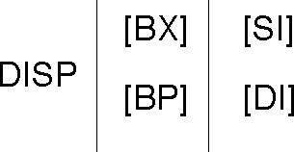
If you choose zero or one items from each of the columns and wind up with at least one item, you've got a valid 8086 memory addressing mode. Some examples:
Choose disp from column one, nothing from column two, [di] from column 3, you get disp[di].
Choose disp, [bx], and [di]. You get disp[bx][di].
Skip column one & two, choose [si]. You get [si]
Skip column one, choose [bx], then choose [di]. You get [bx][di]
disp[dx][si]

Slide 33
Flag Register

Slide 34
Carry Flag (CF) - this flag is set to 1 when there is an unsigned overflow. For example when you add bytes 255 + 1 (result is not in range 0...255). When there is no overflow this flag is set to 0.
Parity Flag (PF) - this flag is set to 1 when there is even number of one bits in result, and to 0 when there is odd number of one bits.
Auxiliary Flag (AF) - set to 1 when there is an unsigned overflow for low nibble (4 bits).
Zero Flag (ZF) - set to 1 when result is zero. For non-zero result this flag is set to 0.
Sign Flag (SF) - set to 1 when result is negative. When result is positive it is set to 0. (This flag takes the value of the most significant bit.)
Trap Flag (TF) - Used for on-chip debugging.

Slide 35
Interrupt enable Flag (IF) - when this flag is set to 1 CPU reacts to interrupts from external devices.
Direction Flag (DF) - this flag is used by some instructions to process data chains, when this flag is set to 0 - the processing is done forward, when this flag is set to 1 the processing is done backward.
Overflow Flag (OF) - set to 1 when there is a signed overflow. For example, when you add bytes 100 + 50 (result is not in range -128...127).

Slide 36
SimpleISR proc far mov ax, 0 iret SimpleISR endp
Memory Map of 8086 (for PC)
↑ ↑
⏐ 64 K | ROM BIOS | F0000H - FFFFFH
⏐ ↓
384 K ROM | ROM BASIC | Present in older computers
⏐
⏐ | Reserved ROM
⏐
↓ | Video BIOS ROM | C0000H - C7FFFH
↑
⎢ A0000H | Video RAM | A0000H - BFFFFH
⎢
⎢
⎜ | User RAM
640 K RAM
⎜
⎜ | Resident portion of DOS | Varies between 12 K to 40 K
⎜
⎜ | BIOS and DOS data area | 00400H - 005FFH
↓ 1 K | Interrupt Vector Table | 00000H - 003FFH

